Slide 1





TPP-Gaze: Modelling Gaze Dynamics
in Space and Time with Neural Temporal Point Processes
Alessandro D’Amelio, Giuseppe Cartella, Vittorio Cuculo, Manuele Lucchi, Marcella Cornia, Rita Cucchiara, Giuseppe Boccignone

Slide 2
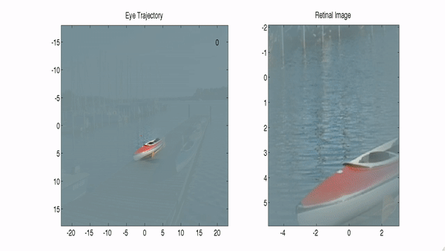
Visual Attention - A spatio-temporal Process

Slide 3

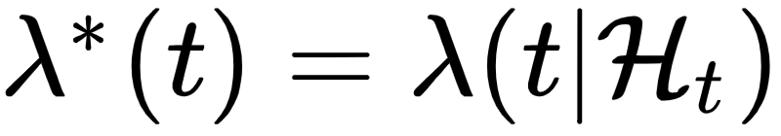
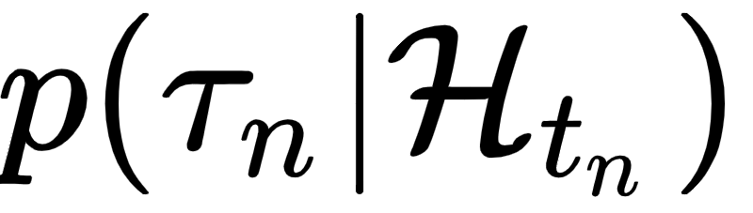

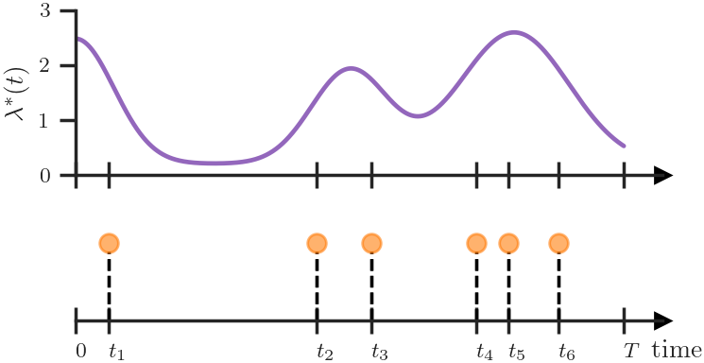
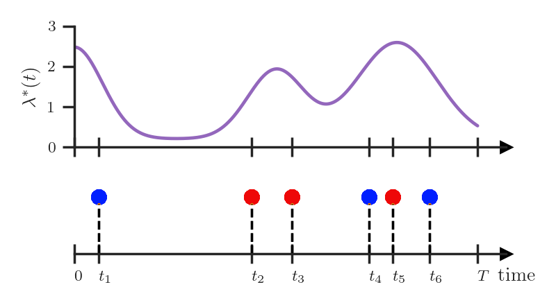
(Marked) Temporal Point Processes
Generic events happening irregularly at:
Temporal Point Processes (TPPs)
Marked TPPs
Intensity Function:
Conditional inter-arrival time
probability
Conditional joint mark and inter-arrival time
probability
https://shchur.github.io/blog/2020/tpp1-conditional-intensity/

Slide 4
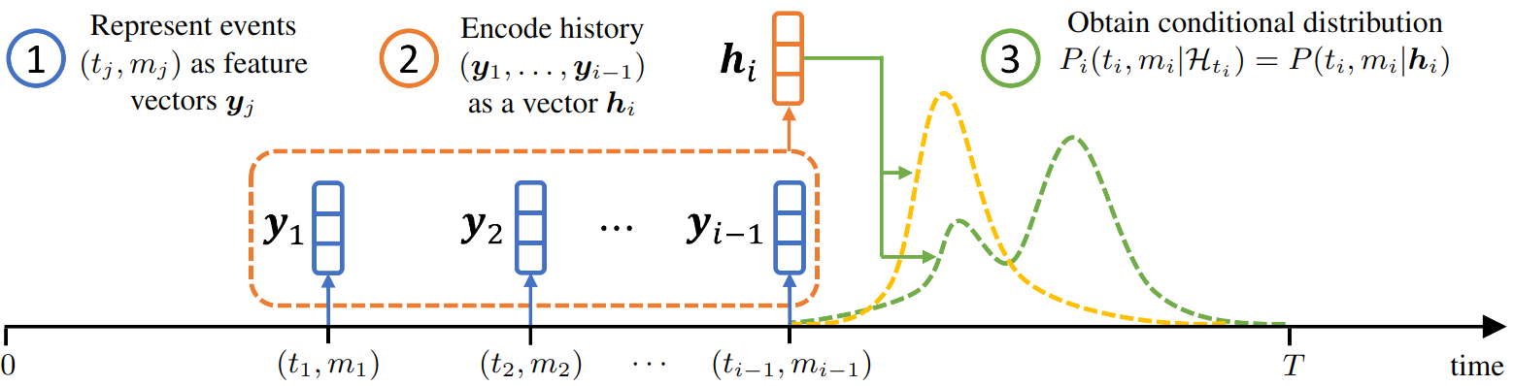
Neural Temporal Point Processes (Neural-TPP)
Shchur, Oleksandr, et al. "Neural temporal point processes: A review." IJCAI (2021).
Shchur, O., Biloš, M., & Günnemann, S. (2020). Intensity-free learning of temporal point processes. ICLR (2020)

Slide 5
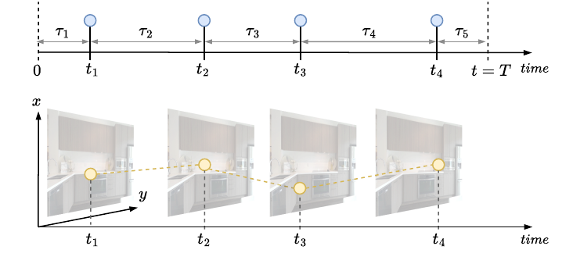
Scanpaths as Marked Temporal Point Processes
A sequence of events (fixations) happening at irregular intervals (fixations duration).
A scanpath as a realisation of a TPP:

Slide 6

TPP-Gaze: Neural-TPP for Scanpath Prediction

Slide 7
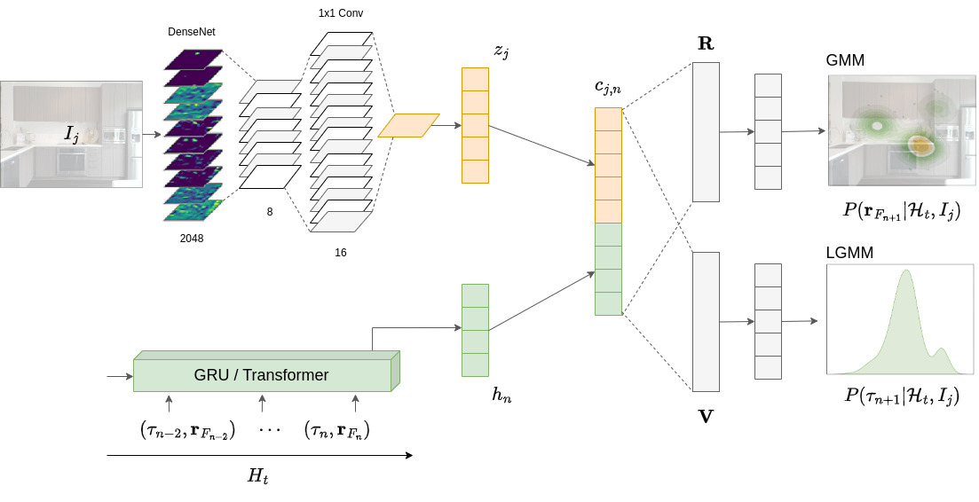

TPP-Gaze: Neural-TPP for Scanpath Prediction

Slide 8
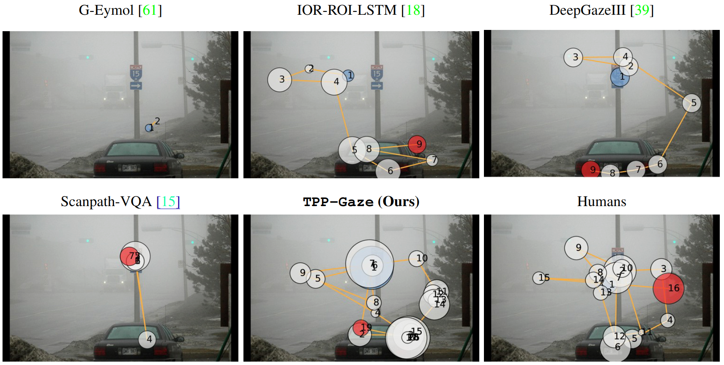
Results: Scanpath Prediction
Yang, Zhibo, et al. "Predicting human attention using computational attention." CVPR (2023).

Slide 9
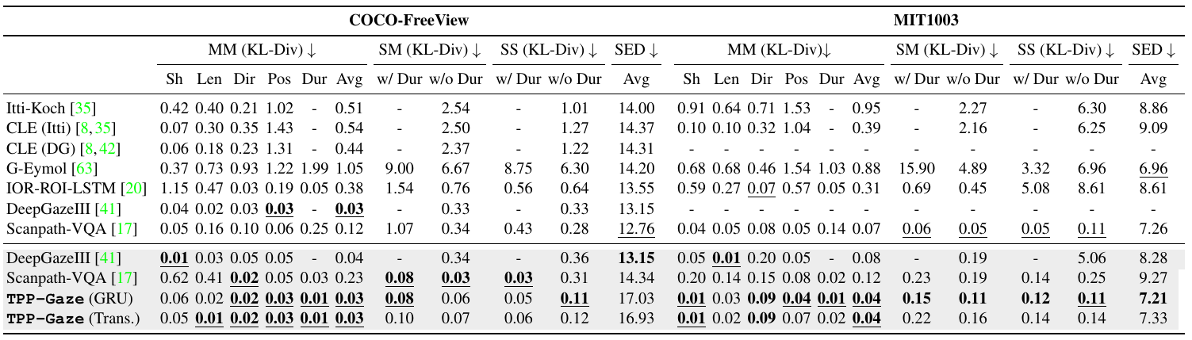
Results: Scanpath Prediction
Yang, Zhibo, et al. "Predicting human attention using computational attention." CVPR (2023).
Judd, Tilke, et al. "Learning to predict where humans look." ICCV (2009).

Slide 10
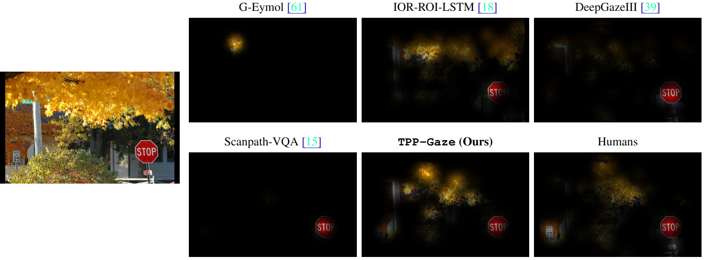
Results: Saliency Prediction
Yang, Zhibo, et al. "Predicting human attention using computational attention." CVPR (2023).

Slide 11
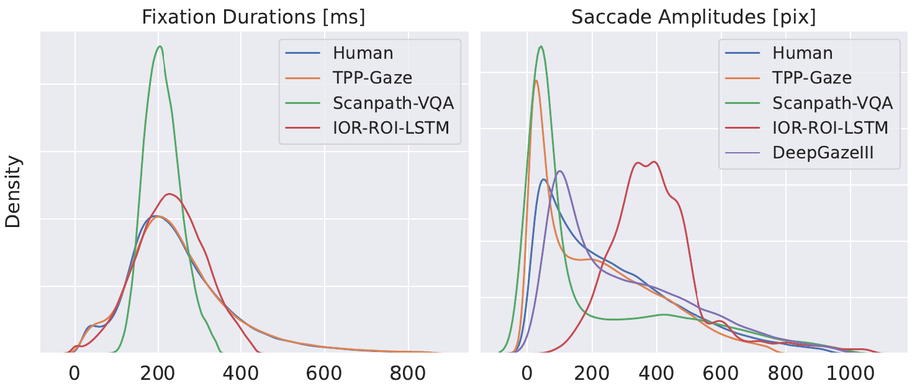
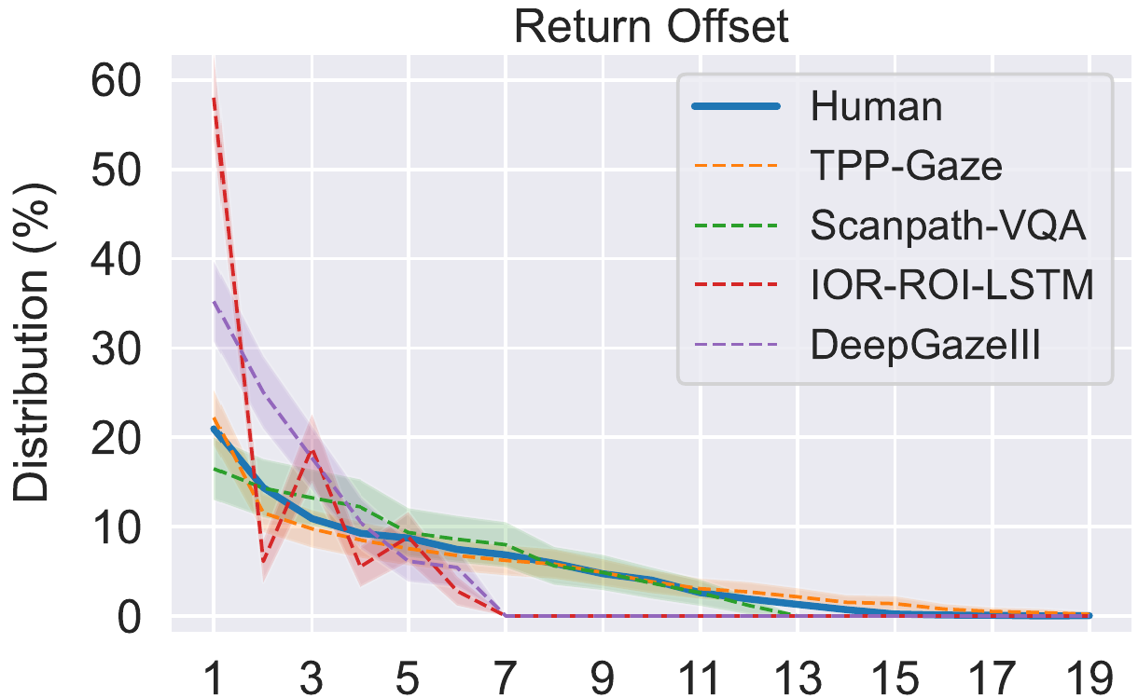
Results: Return Fixations and SP statistics
Statistical properties of simulated Scanpaths closely resemble those from real observers
Return fixations patterns better in alignment with real ones if compared to SOTA
Zhang, Mengmi, et al. "Look twice: A generalist computational model predicts return fixations across tasks and species." PLoS computational biology (2022).

Slide 12
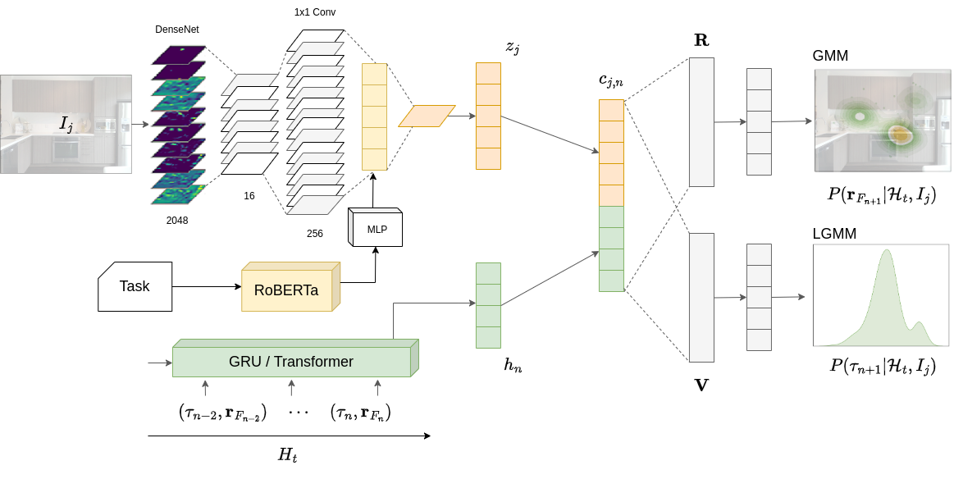
Beyond Free-Viewing: TPP-Gaze for Visual Search

Slide 13
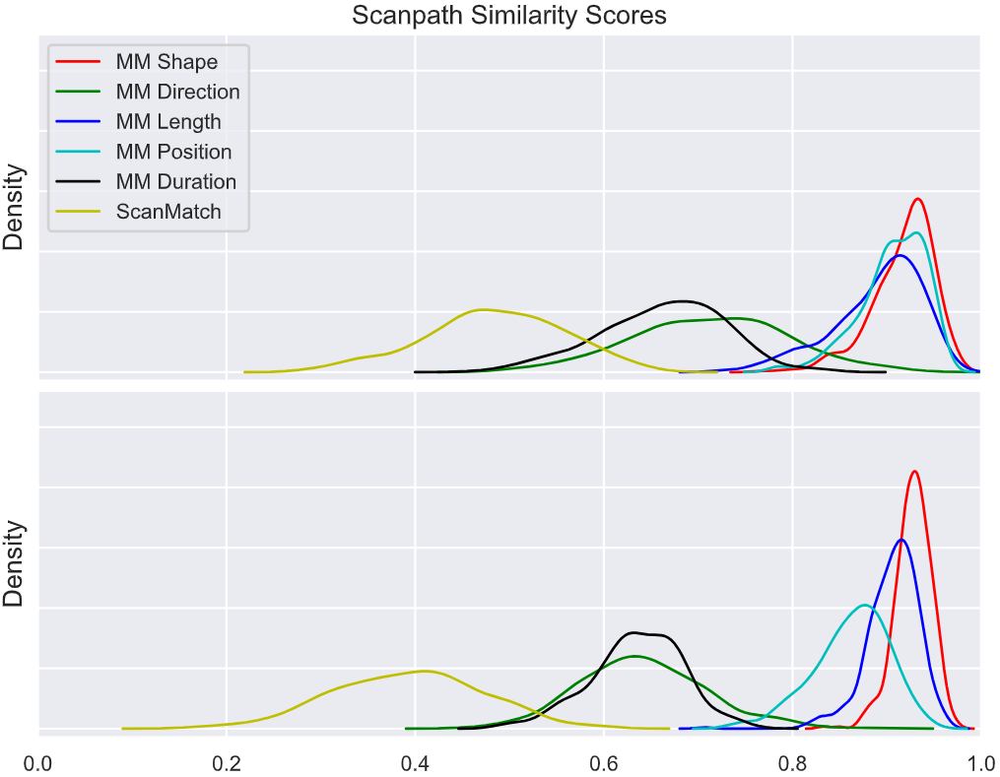
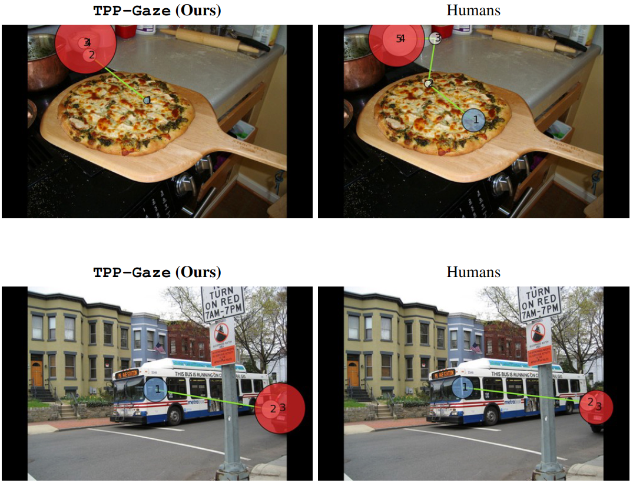
Visual Search: Results
Chen, Yupei, et al. "Coco-search18 fixation dataset for predicting goal-directed attention control." Scientific reports 11.1 (2021).

Slide 14

Conclusions
We presented TPP-Gaze, a novel approach that models the evolution of visual attention through scanpaths using Neural Temporal Point Processes.
TPP-Gaze allows for a mathematically principled modelling of both fixations position and corresponding duration.
Overall state-of-the-art performance across 5 publicly available datasets
TPP-Gaze presents human-like return fixation patterns and scanpath statistics, without being explicitly trained for those objectives
It also delivers competitive results on saliency prediction and task-driven attention allocation.
Github Repository

