Slide 1

Trends, Applications, and Challenges in
Human Attention Modelling
G. Cartella¹, M. Cornia¹, V. Cuculo¹, A. D’Amelio², D. Zanca³, G. Boccignone², R. Cucchiara¹

Slide 2
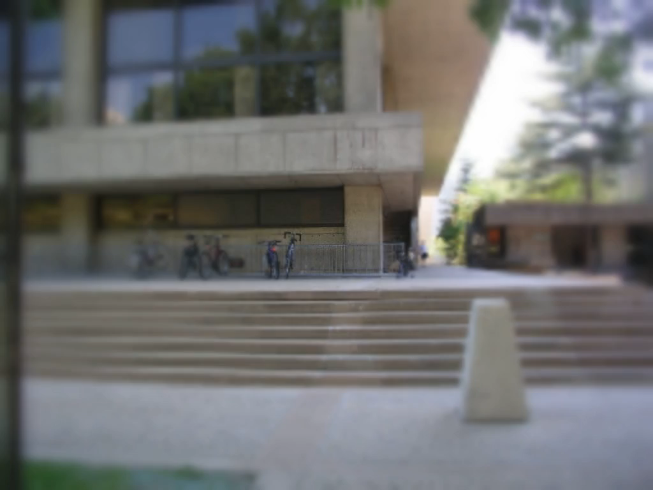
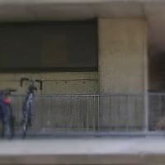
Introduction
Visual attention enables humans to rapidly analyze complex scenes and devote their limited cognitive resources to the most attractive regions.
Retinal Image
The world as we perceive it a time t

Slide 3
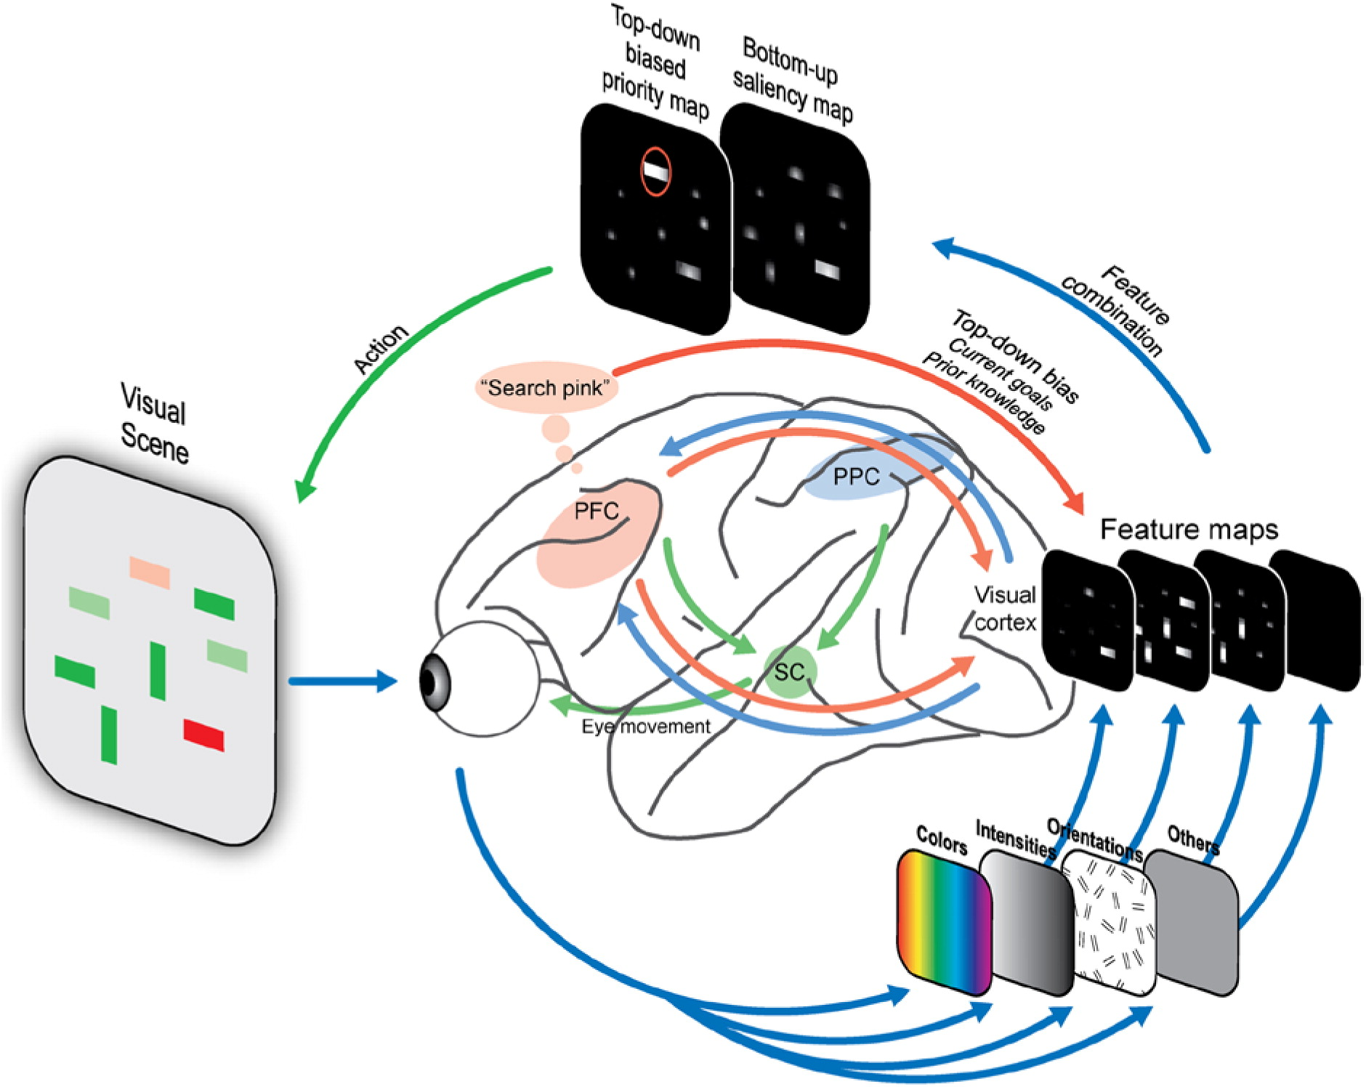
Introduction
Computational approaches aim at modelling visual attention as the combination of bottom-up (early salience) and top-down (task-dependent attention) components.
Katsuki, Fumi, and Christos Constantinidis. "Bottom-up and top-down attention: different processes and overlapping neural systems." The Neuroscientist (2014).

Slide 4
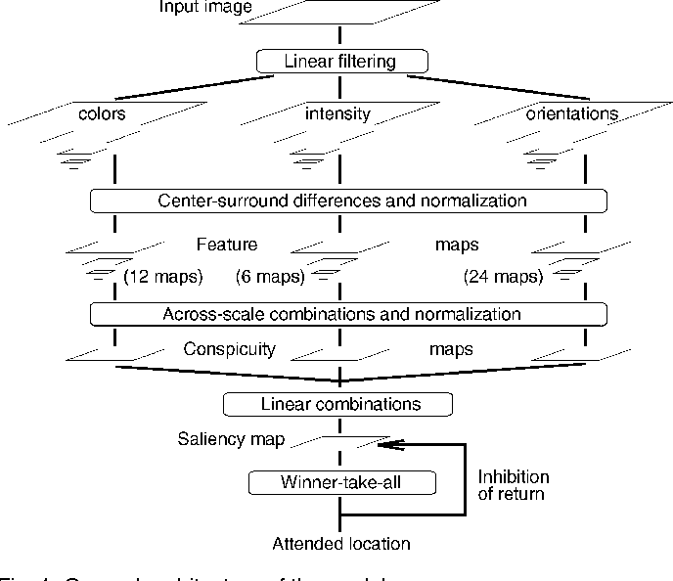
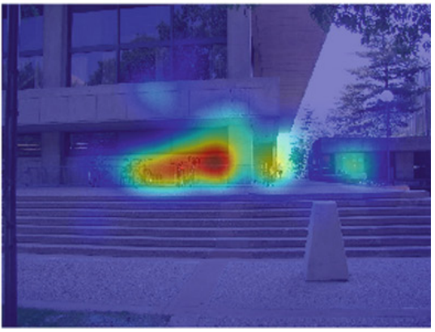
Human Attention Modelling
Saliency Prediction
The perceptual representation of the world W is usually summarized in the form of a spatial saliency map, offering a visualization of the most prominent regions.
Itti, Laurent, Christof Koch, and Ernst Niebur. "A model of saliency-based visual attention for rapid scene analysis." IEEE TPAMI (1998): 1254-1259.
Jiang, Ming, et al. "Salicon: Saliency in context." Proceedings of the IEEE CVPR. 2015.
Aydemir, Bahar, et al. "TempSAL-uncovering temporal information for deep saliency prediction." Proceedings of the IEEE/CVF CVPR. 2023.

Slide 5
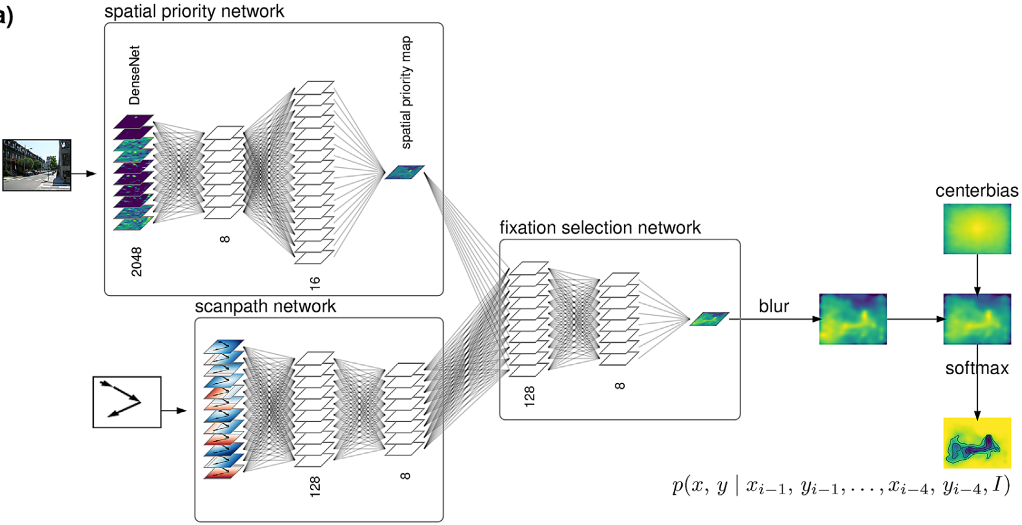
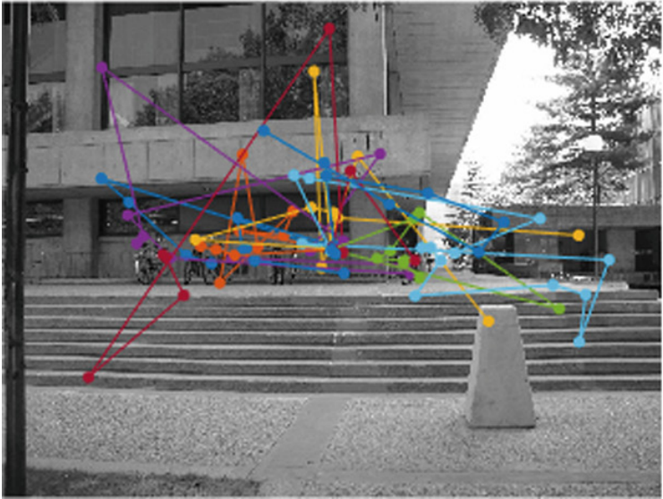
Human Attention Modelling
Scanpath Prediction
The exploration order of a visual stimulus is of particular importance since it better reflects the conspicuity of the image elements with respect to the observer, as well as the internal strategy.
Le Meur, Olivier, and Zhi Liu. "Saccadic model of eye movements for free-viewing condition." Vision research (2015).
Kümmerer, Matthias, Matthias Bethge, and Thomas SA Wallis. "DeepGaze III: Modeling free-viewing human scanpaths with deep learning." Journal of Vision (2022).
Mondal, Sounak, et al. "Gazeformer: Scalable, effective and fast prediction of goal-directed human attention." Proceedings of the IEEE/CVF CVPR. 2023.

Slide 6
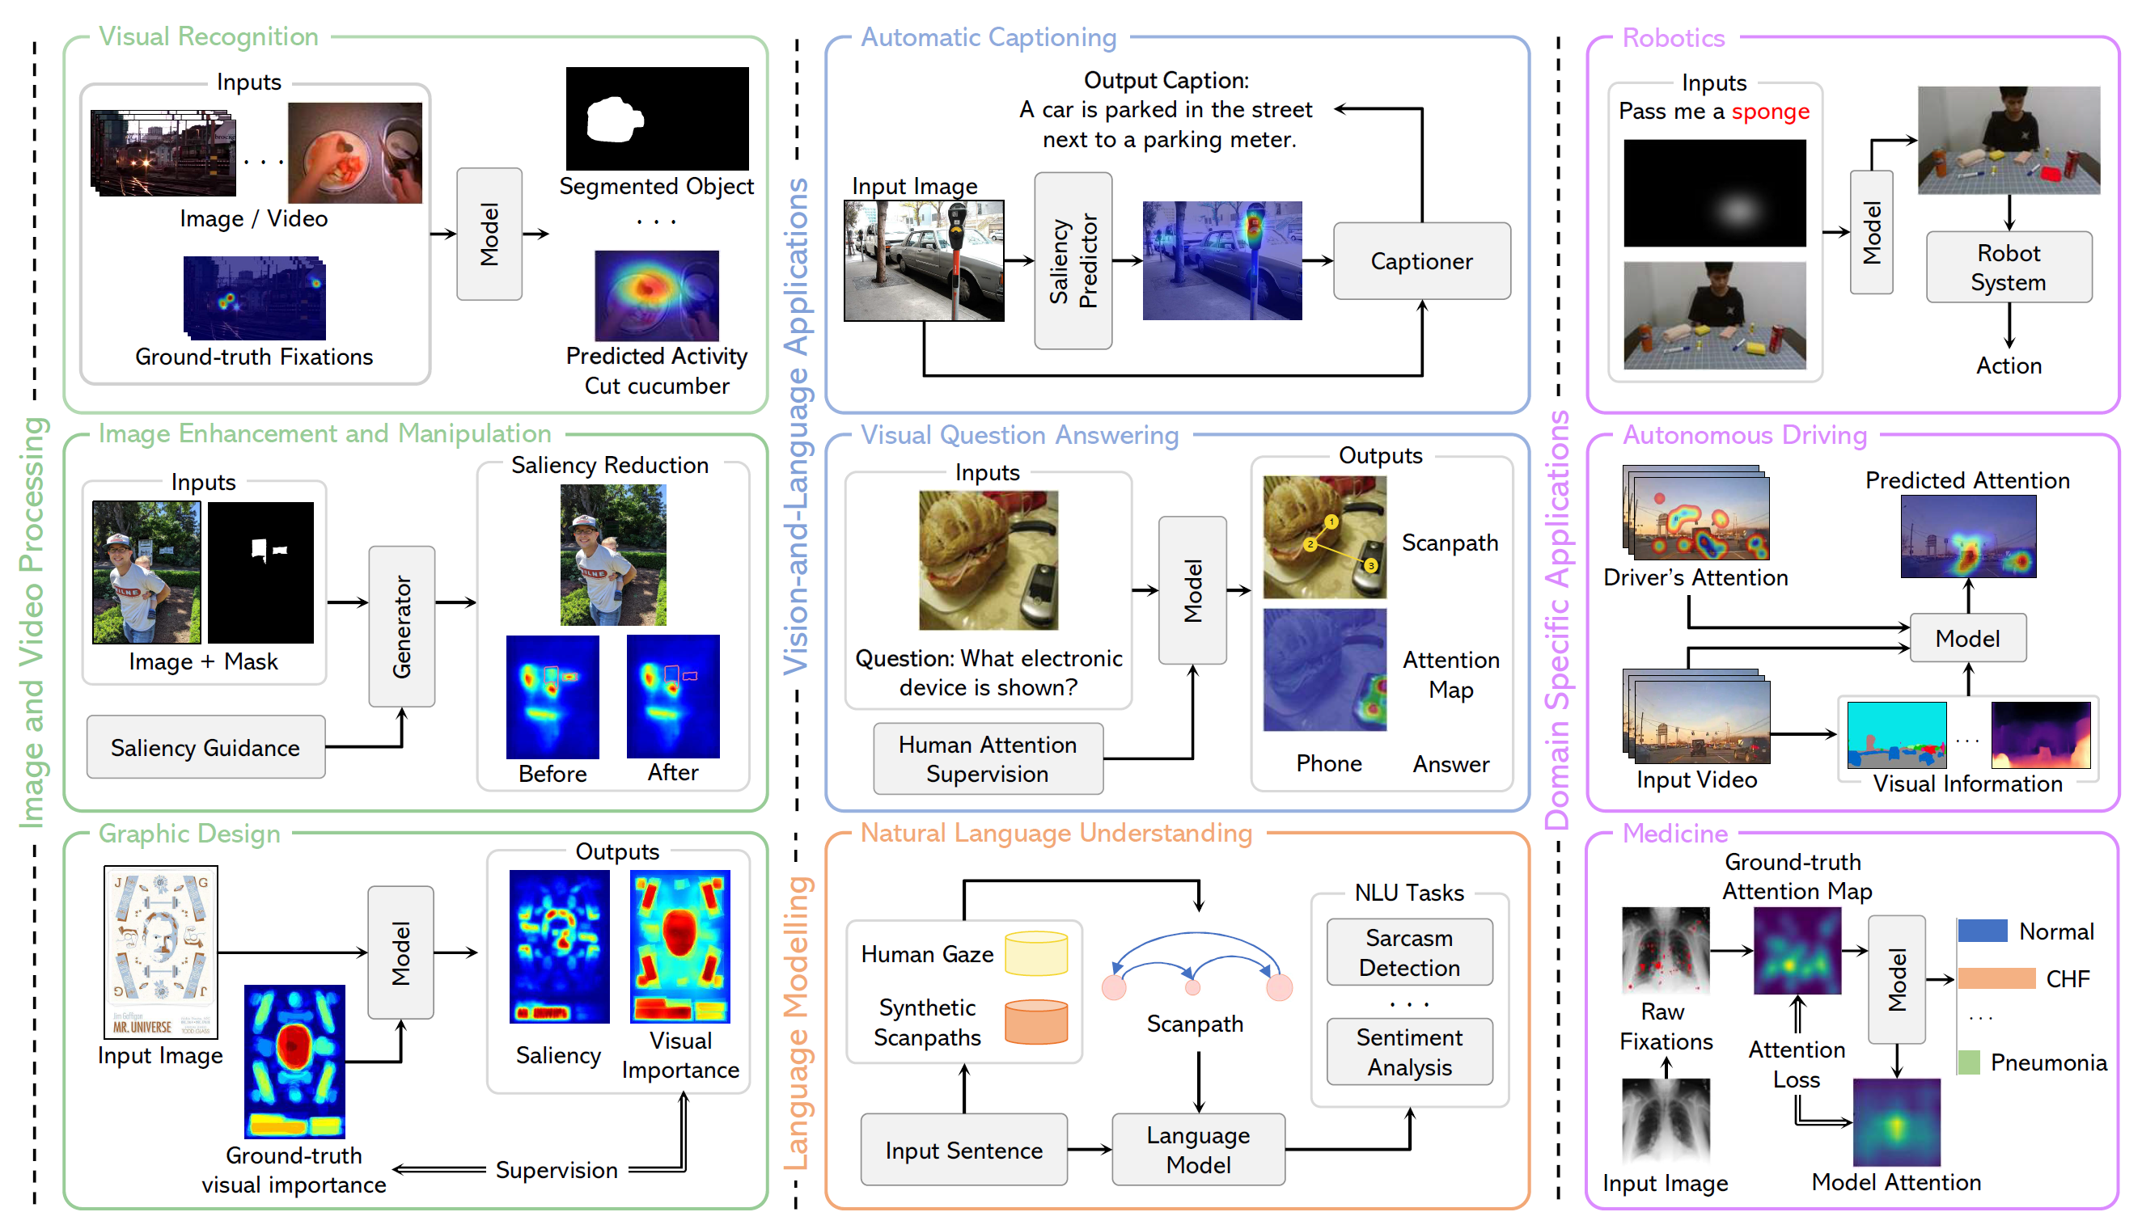
Overview

Slide 7
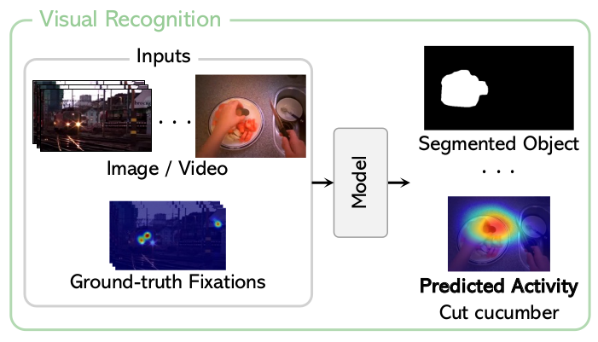
Applications in AI
Image and video processing
Human gaze data assists AI models in detecting salient objects in videos, segmenting videos without supervision, and recognizing activities in egocentric video sequences.
Wang, Wenguan, et al. "Learning unsupervised video object segmentation through visual attention." Proceedings of the IEEE/CVF CVPR. 2019.
Min, Kyle, and Jason J. Corso. "Integrating human gaze into attention for egocentric activity recognition." Proceedings of the IEEE/CVF WACV. 2021.
Qiao, Minglang, et al. "Joint learning of audio–visual saliency prediction and sound source localization on multi-face videos." IJCV (2023).

Slide 8
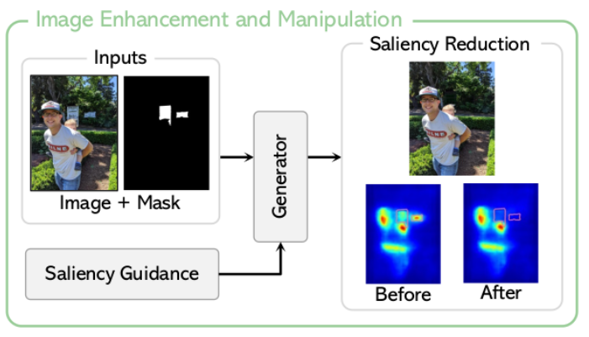
Applications in AI
Image and video processing
Human saliency is adopted as guidance to manipulate and enhance images. The aim is to automatically reduce visual distraction while increasing the attractiveness of the desired objects within the scene
Jiang, Lai, et al. "Saliency-guided image translation." Proceedings of the IEEE/CVF CVPR. 2021.
Aberman, Kfir, et al. "Deep saliency prior for reducing visual distraction." Proceedings of the IEEE/CVF CVPR. 2022.
Miangoleh, S. Mahdi H., et al. "Realistic saliency guided image enhancement." Proceedings of the IEEE/CVF CVPR. 2023.

Slide 9
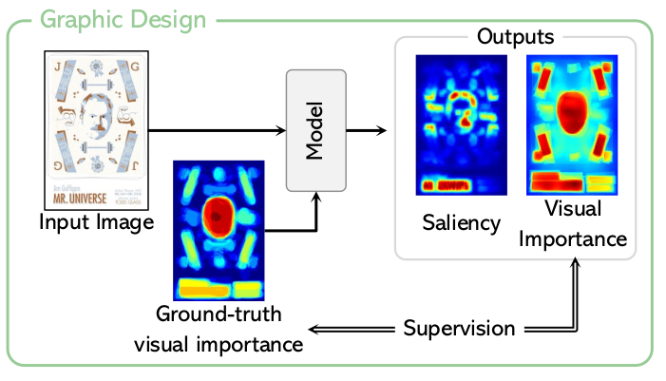
Applications in AI
Image and video processing
Visual attention allocation in graphic designs can be interpreted as a proxy for the perceived relative importance of design elements.
Leiva, Luis A., et al. "Understanding visual saliency in mobile user interfaces." Proceedings of ACM MobileHCI, 2020.
Fosco, Camilo, et al. "Predicting visual importance across graphic design types." Proceedings of ACM UIST. 2020.

Slide 10
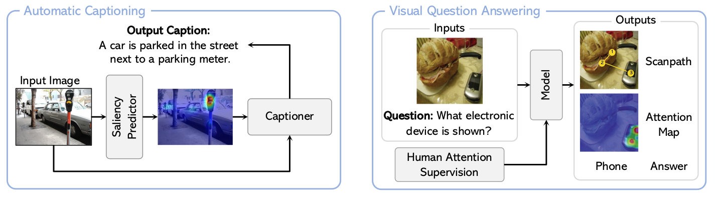
Applications in AI
Vision-and-Language Applications
Raw fixations or saliency maps can be combined with the language model to guide the caption generation or guides VQA models to generate human-like attention maps and promoting reasoning behaviour.
He, Sen, et al. "Human attention in image captioning: Dataset and analysis." Proceedings of the IEEE/CVF ICCV. 2019.
Takmaz, Ece, et al. "Generating Image Descriptions via Sequential Cross-Modal Alignment Guided by Human Gaze." Proceedings of EMNLP. 2020.
Sood, Ekta, et al. "Multimodal integration of human-like attention in visual question answering." Proceedings of the IEEE/CVF CVPR. 2023.

Slide 11
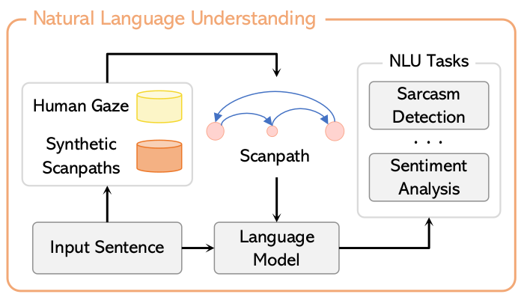
Applications in AI
Language Modelling
Machine Reading Comprehension
Eye movement patterns are used to infer the reader’s native language.
Natural Language Understanding
Models generate scanpaths from existing eye-tracking corpora, improving performance on tasks such as sentiment analysis and sarcasm detection.
Sood, Ekta, et al. "Improving natural language processing tasks with human gaze-guided neural attention." NeurIPS (2020): 6327-6341.
Reich, David Robert, et al. "Inferring native and non-native human reading comprehension and subjective text difficulty from scanpaths in reading." ETRA. 2022.
Deng, Shuwen, et al. "Pre-Trained Language Models Augmented with Synthetic Scanpaths for Natural Language Understanding." Proceedings of EMNLP. 2023.

Slide 12
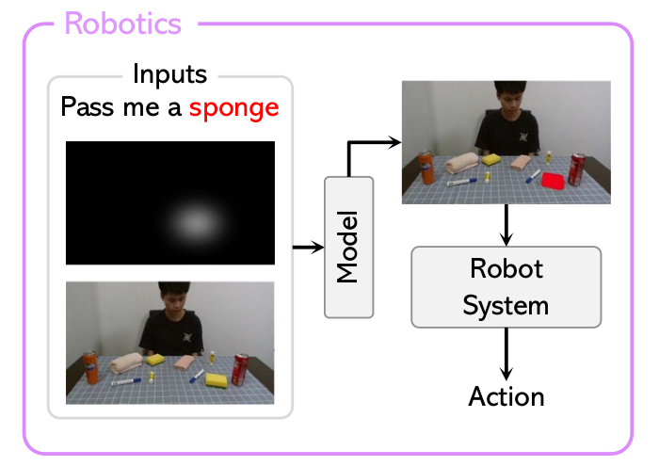
Domain-specific applications
Robotics
In collaborative robotics, robot assistance can be enabled by individuals directing their gaze towards a specific target they wish to grasp or manipulate. Control systems able to accommodate eye-gaze input modalities have been developed.
Saran, Akanksha, et al. "Understanding teacher gaze patterns for robot learning." Conference on Robot Learning. PMLR, 2020.
Aronson, Reuben M., and Henny Admoni. "Gaze complements control input for goal prediction during assisted teleoperation." Robotics science and systems. 2022.
Qian, Kun, et al. "Gvgnet: Gaze-directed visual grounding for learning under-specified object referring intention." IEEE Robotics and Automation Letters (2023).

Slide 13
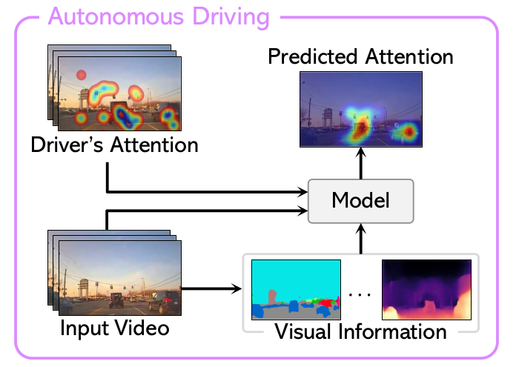
Domain-specific applications
Autonomous Driving
Inverse reinforcement learning can be adopted to learn an attention policy treating each fixation point as a potential source of reward. Some works modelled the human peripheral vision and introduced a gaze detection model augmented by the scene semantics.
Palazzi, Andrea, et al. "Predicting the driver's focus of attention: the dr (eye) ve project." IEEE TPAMI 41.7 (2018): 1720-1733.
Pal, Anwesan, et al. "Looking at the right stuff - Guided semantic-gaze for autonomous driving". Proceedings of the IEEE/CVF CVPR 2020.
Baee, Sonia, et al. "Medirl: Predicting the visual attention of drivers via maximum entropy deep inverse reinforcement learning." Proceedings of the IEEE/CVF ICCV 2021.

Slide 14
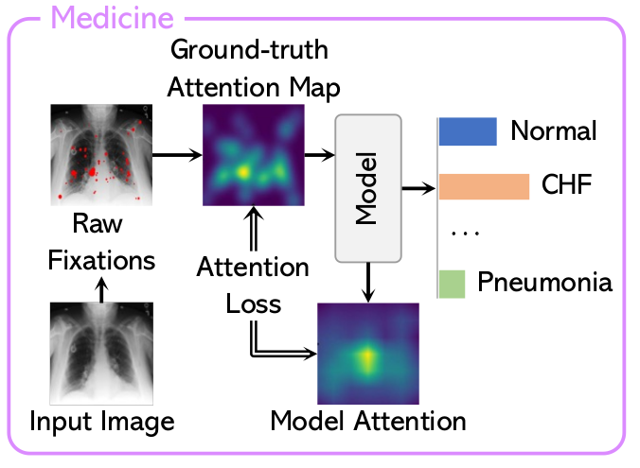
Domain-specific applications
Medicine
Human gaze emerges as a natural way to capture visual attention during the diagnosis process. Eye movements from an expert are recorded and raw fixations are converted into a visual attention map to guide model attention towards the most discriminative regions.
Karargyris, Alexandros, et al. "Creation and validation of a chest X-ray dataset with eye-tracking and report dictation for AI development." Scientific data 8.1 (2021).
Ma, Chong, et al. "Eye-gaze-guided vision transformer for rectifying shortcut learning." IEEE Transactions on Medical Imaging 42.11 (2023).
Wang, Bin, et al. "Gazegnn: A gaze-guided graph neural network for chest x-ray classification." Proceedings of the IEEE/CVF WACV 2024.

Slide 15
Challenges
Data scarcity
Collecting human gaze data is expensive in terms of costs and time.
Privacy issues
Data acquisition through wearable devices raises a new challenge concerning ethical and privacy-aware collection and sharing.

Slide 16
Future directions
Synthetic data
In the NLP community, the integration of synthetic scanpath generation with a scanpath-augmented language model has shown promising results, eliminating the need for human gaze data. However, minimal exploration has been undertaken in computer vision.
Wearable devices
The use of wearable devices such as smart glasses and augmented reality headsets would allow large amounts of data to be collected efficiently and in an ecological setting.

Slide 17


Trends, Applications, and Challenges in Human Attention Modelling
G. Cartella¹, M. Cornia¹, V. Cuculo¹, A. D’Amelio², D. Zanca³, G. Boccignone², R. Cucchiara¹

